Slide 1

Computer Networks
WWW & HTTP
S.V.Jansi Rani
Associate Professor / CSE

Slide 2
AGENDA
World Wide Web (WWW)
Hyper Text Transfer Protocol (HTTP)

Slide 3



Slide 4
WWW

Slide 5
WORLD WIDE WEB
The idea of the Web -Tim Berners-Lee in 1989 at CERN, the European Organization for Nuclear Research
Commercial Web started in the early 1990s.

Slide 6
WORLD WIDE WEB AND HTTP
Web - repository of information – web pages -distributed and linked
Distribution allows the growth of the Web
Linking - one page to refer to another web - hypertext
Now Web is used to provide electronic shopping, gaming , watching TV programs
WWW today is a distributed client-server service
Web page can be simple or composite
26.6

Slide 7




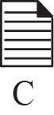

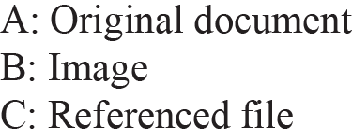





Example

Slide 8
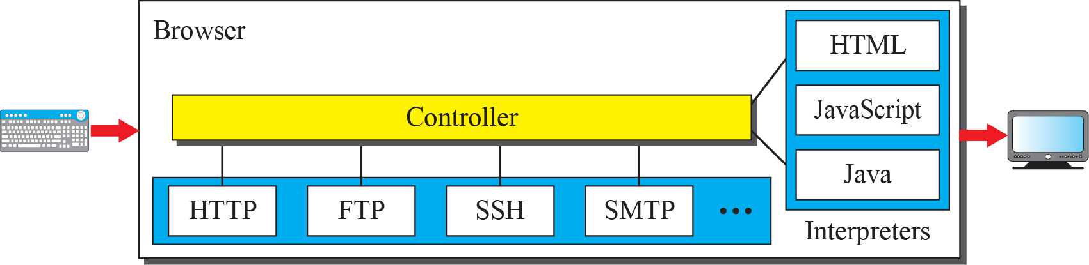
Browser
Web Server - store web pages

Slide 9
URL
http://
https://
ftp://
80 by default

Slide 10
WEB DOCUMENTS
The documents in the WWW can be grouped into three broad categories: static, dynamic, and active. The category is based on the time at which the contents of the document are determined.
Static Documents
Dynamic Documents Active Documents

Slide 11
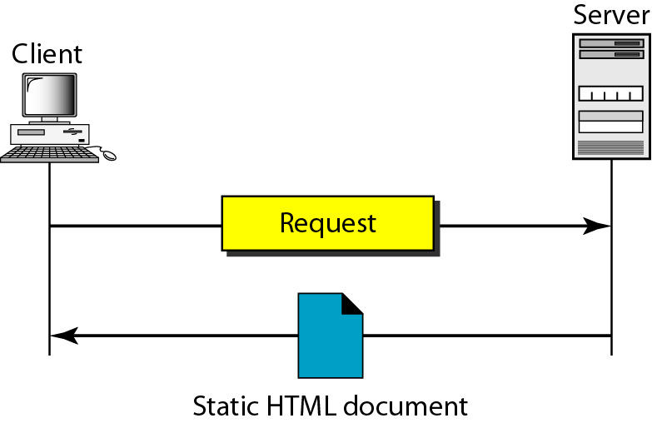
Static document

Slide 12
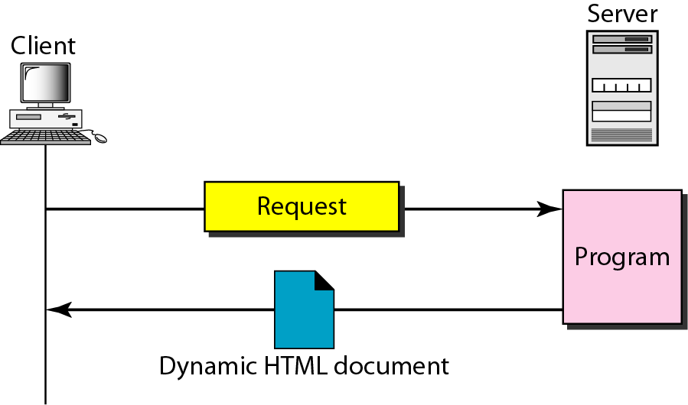
Dynamic document using CGI

Slide 13
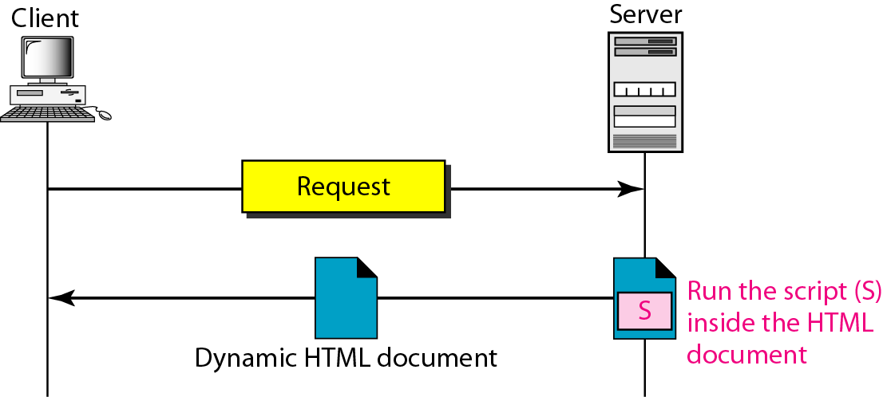
Dynamic document using server-site script

Slide 14

Note
Dynamic documents are sometimes referred to as server-site dynamic documents.

Slide 15
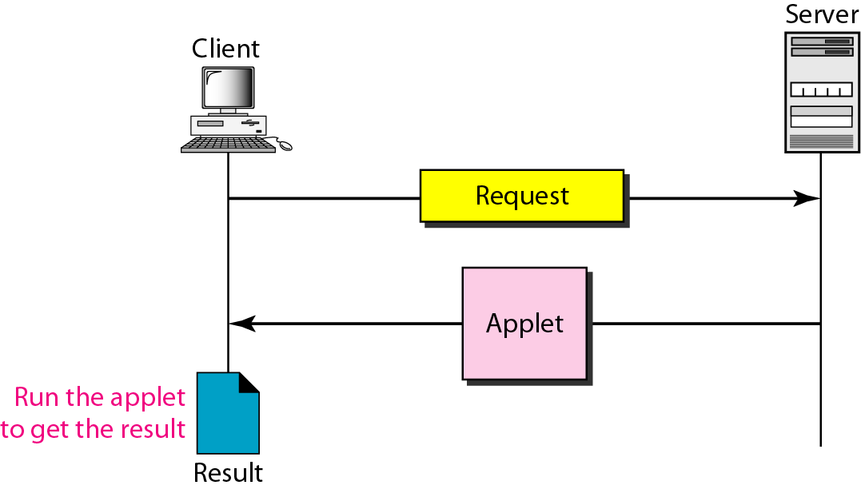
Active document using Java applet

Slide 16
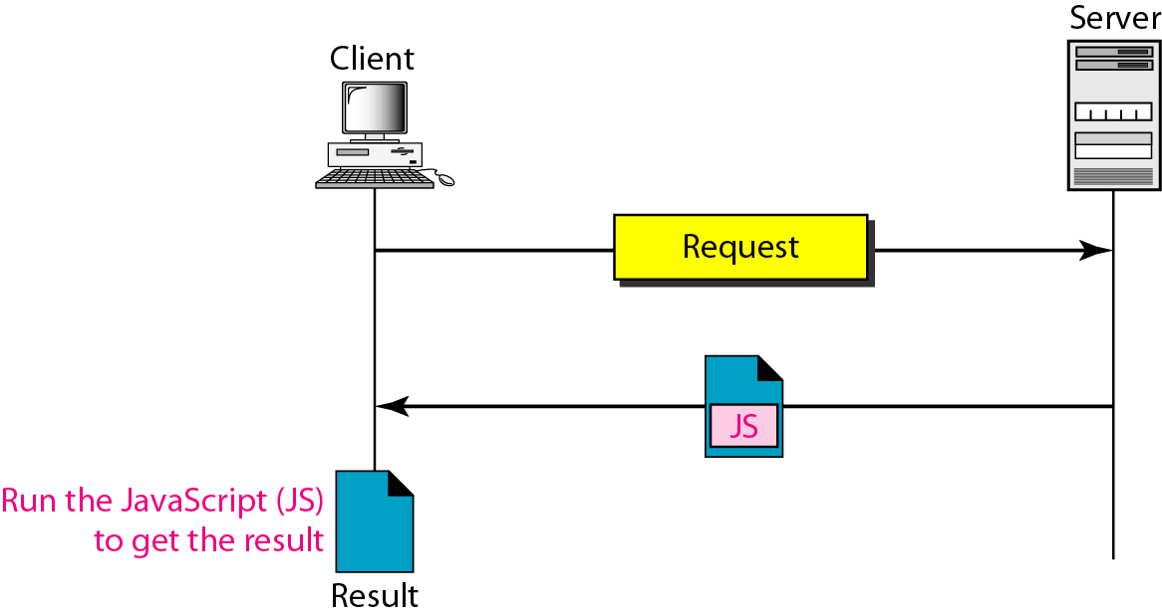
Active document using client-site script

Slide 17
Note
Active documents are sometimes referred to as client-site dynamic documents.

Slide 18
HTTP

Slide 19
HyperText Transfer Protocol
HTTP- retrieve web pages from the Web.
HTTP client -request; an HTTP server - response
Port number 80
HTTP uses the services of TCP - connection-oriented and reliable protocol.
Persistent
Non persistent

Slide 20
Non - Persistent Connection
One TCP connection is made for each request/response.
1. The client opens a TCP connection and sends a request.
2. The server sends the response and closes the connection.
3. The client reads the data until it encounters an end-of-file marker; it then closes the connection.
File contains links to N different pictures in different files (all located on the same server), the connection must be opened and closed N + 1 times.
High overhead on the server

Slide 21
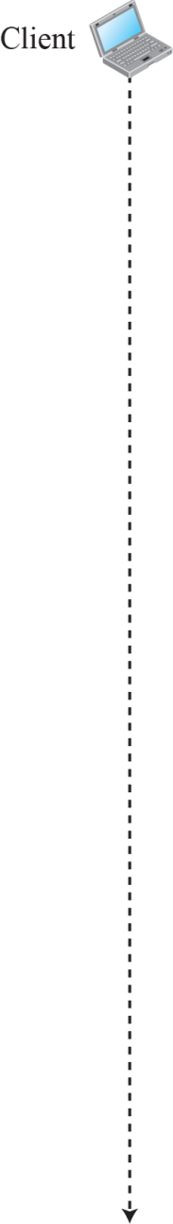
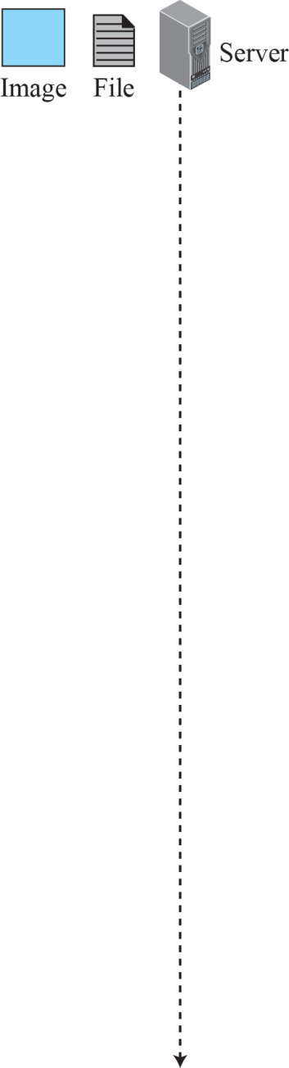
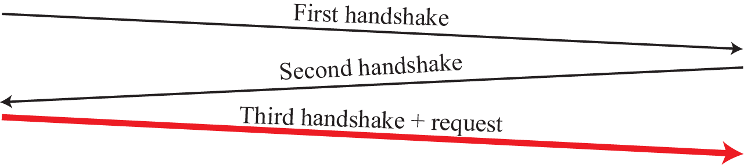

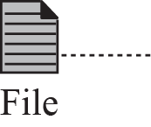
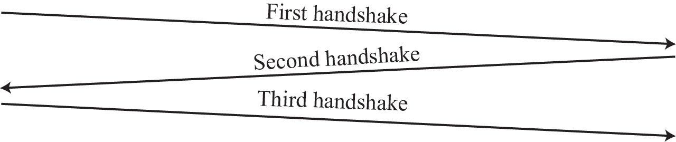

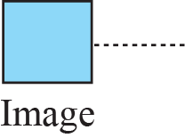
Example

Slide 22
Persistent Connection
HTTP 1.0 specifies PC
Server leaves the connection open for more requests after sending a response.
The server can close the connection at the request of a client or if a time-out has been reached.
Server sends length / if not known finally closes indicating EOF

Slide 23
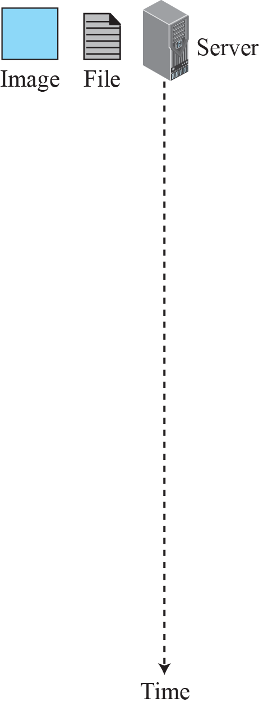
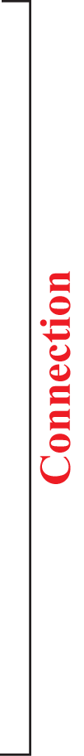
Example

Slide 24
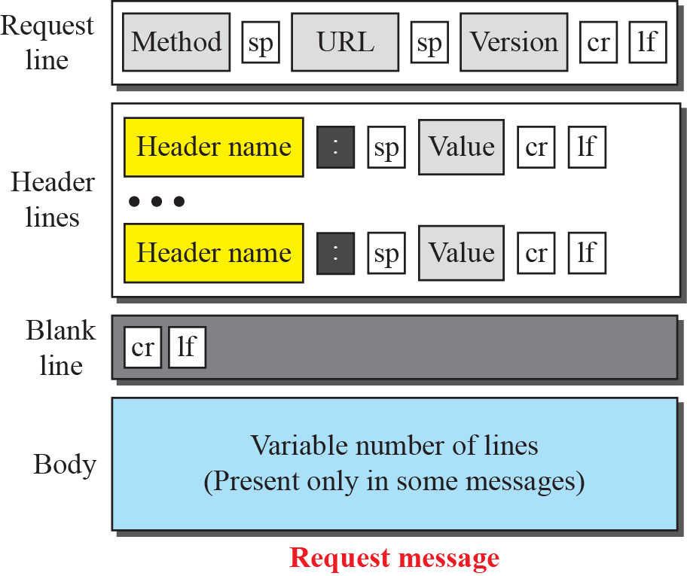
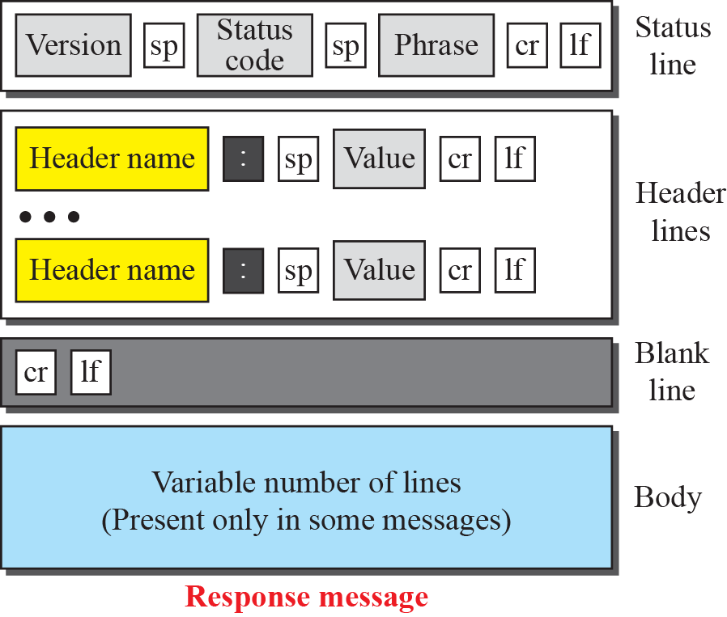
Formats of the request and response messages

Slide 25
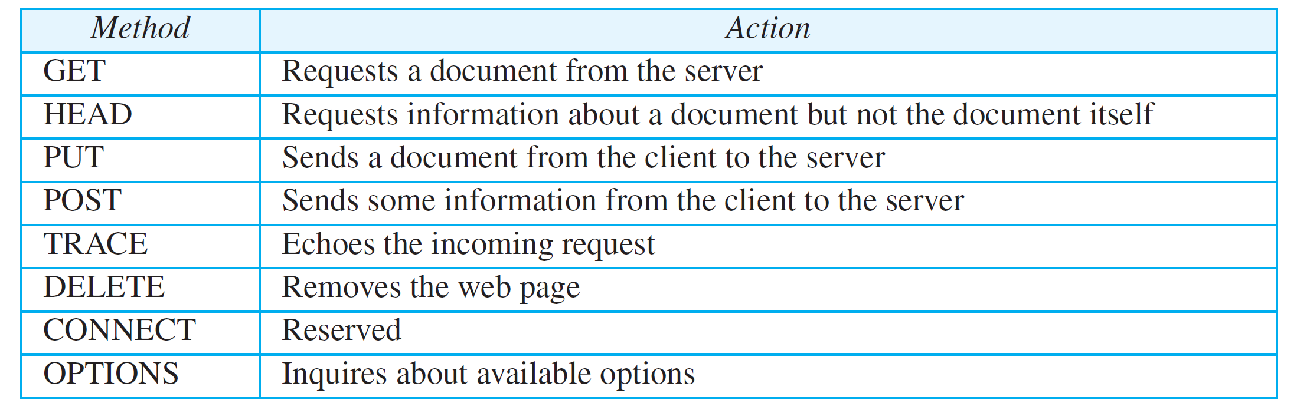
Methods

Slide 26
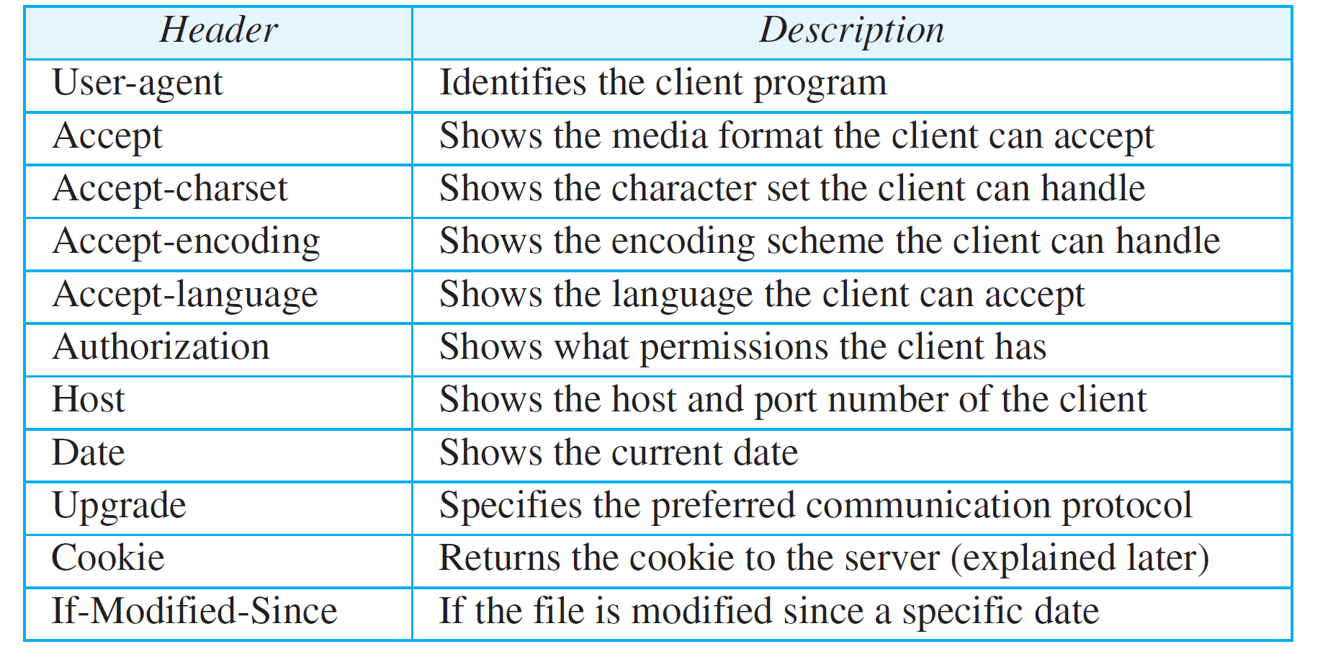
Request Header Names

Slide 27
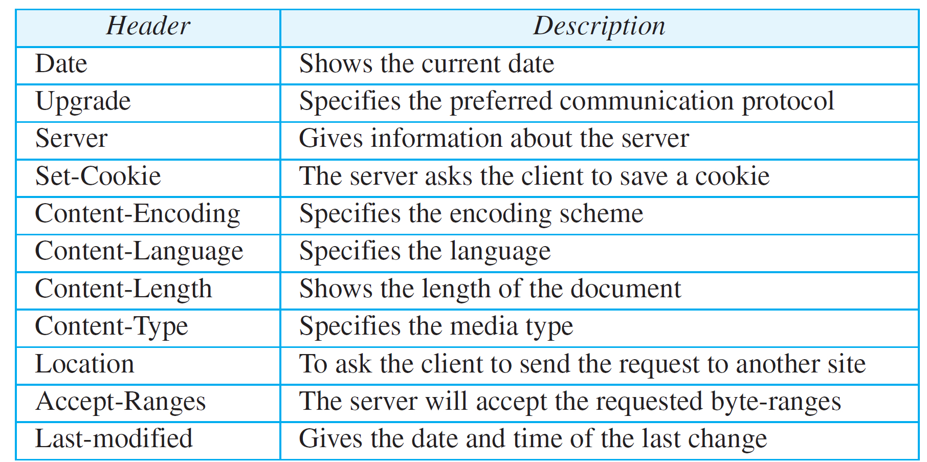
Response Header Names

Slide 28
Status Code
100 range - informational
200 range - successful request
300 range - redirect the client to another URL
400 range - error at the client site
500 range - indicate an error at the server site.
The status phrase explains the status code in text form.

Slide 29
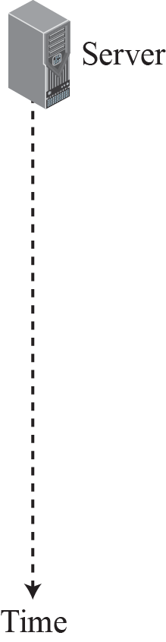
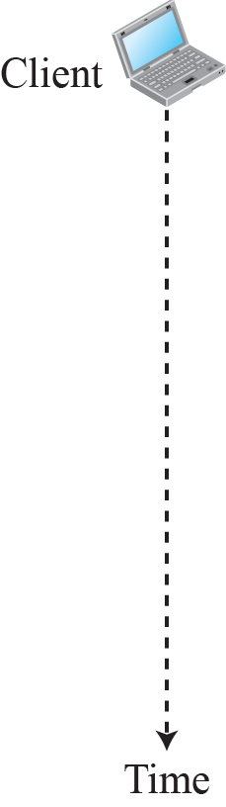
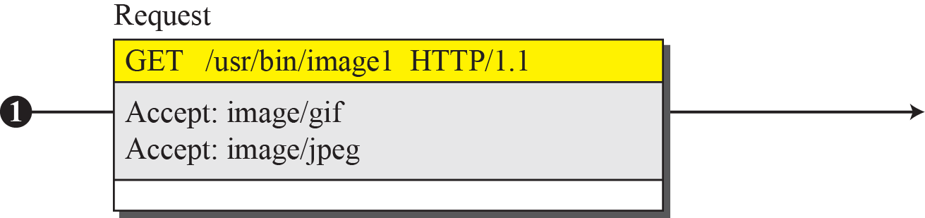
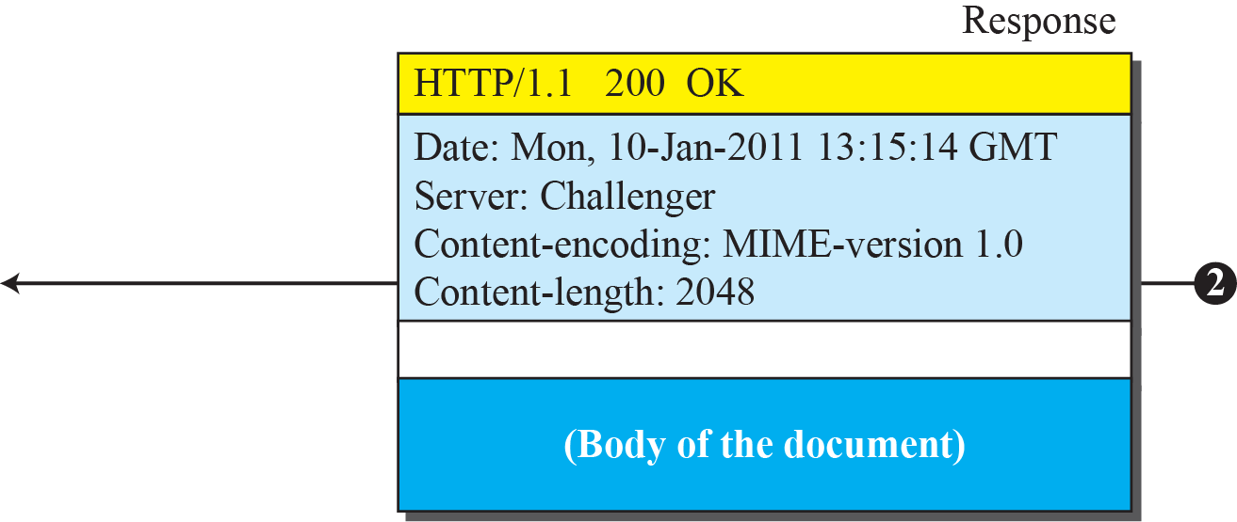
Example

Slide 30
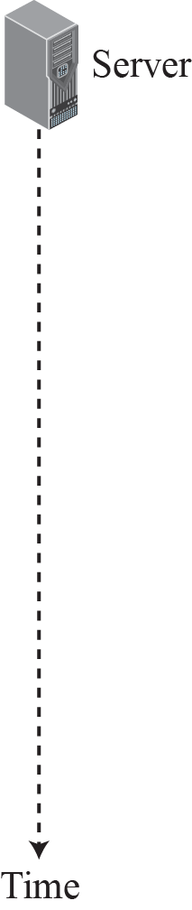
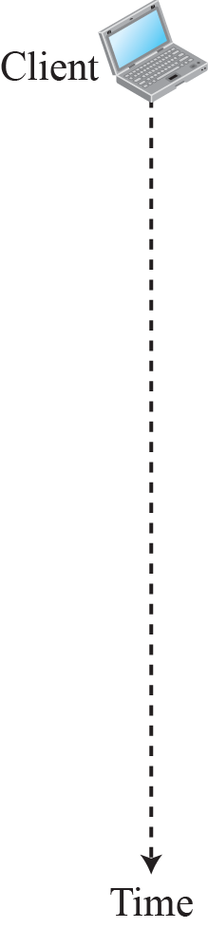
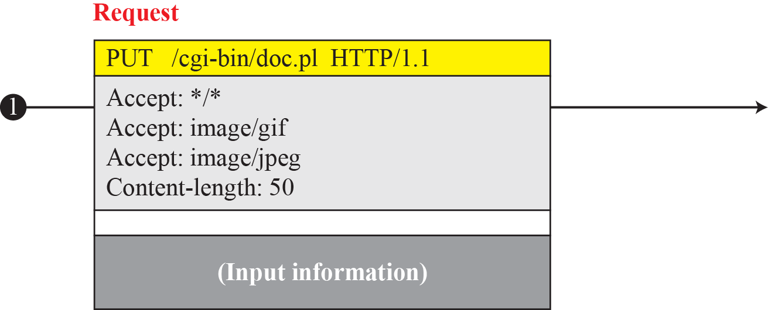
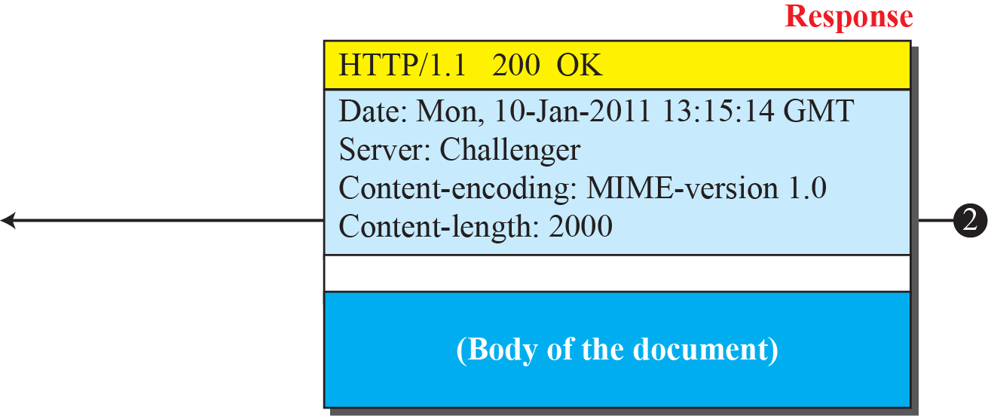
Example

Slide 31
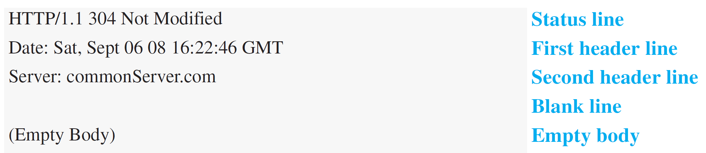
Example - Conditional Request
The following shows how a client imposes the modification data and time condition on a request.
The status line in the response shows the file was not modified after the defined point in time. The body of the response message is also empty.

Slide 32
Cookies
The original purpose of the Web, retrieving publicly available documents, exactly fits this design.
Web has other functions that need to remember some information about the clients; some are listed below:
❑ Websites are being used as electronic stores
❑ Some websites need to allow access to registered clients only.
❑ Some websites are used as portals: the user selects the web pages he wants to see.
❑ Some websites are just advertising agencies.
For these purposes, the cookie mechanism was devised.

Slide 33
Cookies
Creating and Storing Cookies
1. When a server receives a request from a client, it stores information about the client in a file or a string. - the domain name of the client, the contents of the cookie (name, registration number, and so on), a timestamp
2. The server includes the cookie in the response that it sends to the client.
3. When the client receives the response, the browser stores in cookie directory in server domain name

Slide 34
Cookies
Client - request to a server-cookie directory
If found, the cookie is included in the request
Server -old client, not a new one.
Contents of the cookie are never read by the browser or disclosed to the user
It is a cookie made by the server and eaten by the server.

Slide 35
Example
Figure shows a scenario in which an electronic store can benefit from the use of cookies. Assume a shopper wants to buy a toy from an electronic store named BestToys. The shopper browser (client) sends a request to the BestToys server. The server creates an empty shopping cart (a list) for the client and assigns an ID to the cart (for example, 12343). The server then sends a response message, which contains the images of all toys available, with a link under each toy that selects the toy if it is being clicked. This response message also includes the Set-Cookie header line whose value is 12343. The client displays the images and stores the cookie value in a file named BestToys.

Slide 36
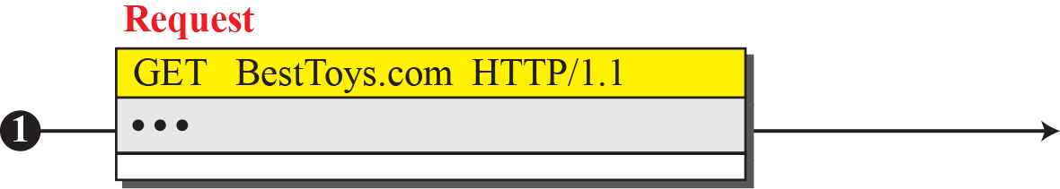
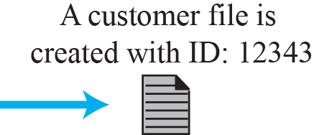
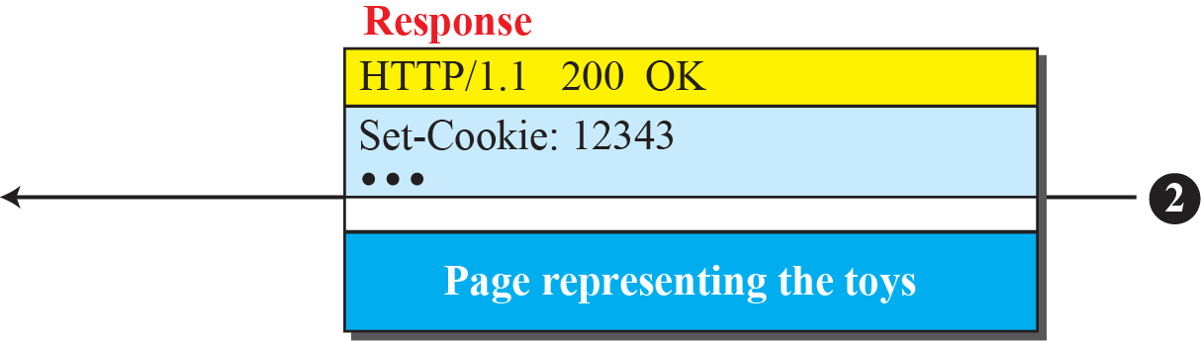

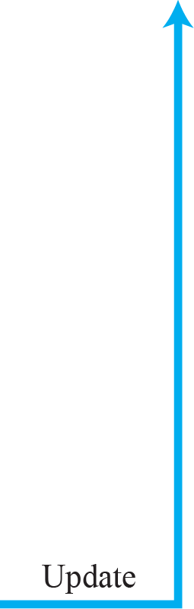
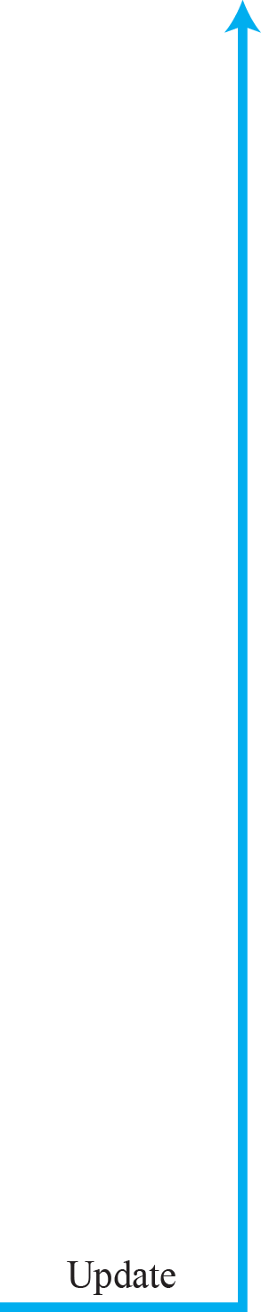
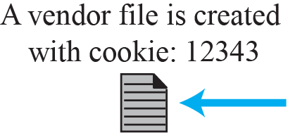
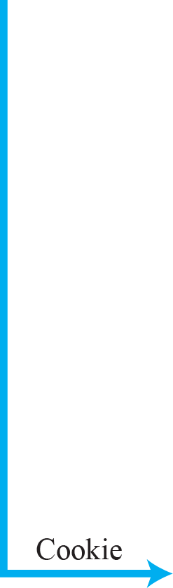
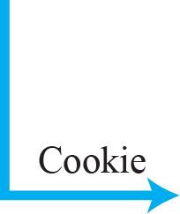
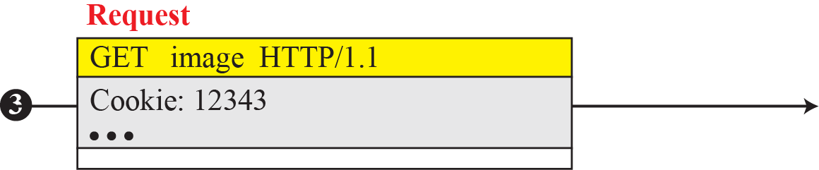
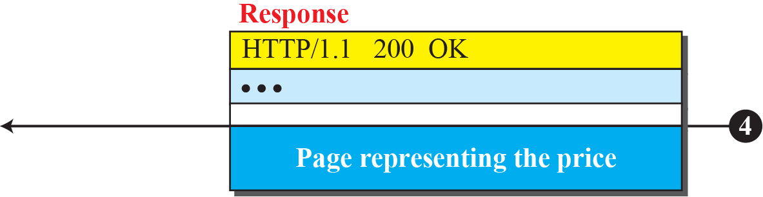
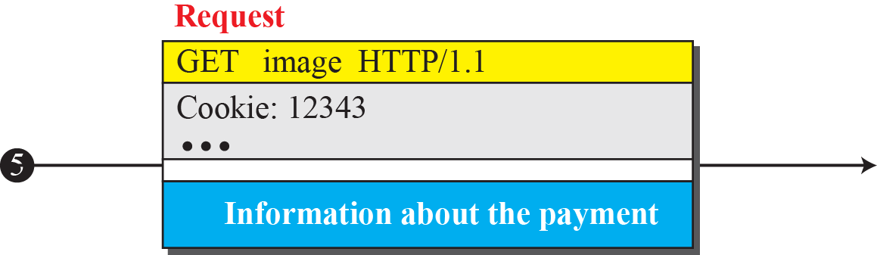
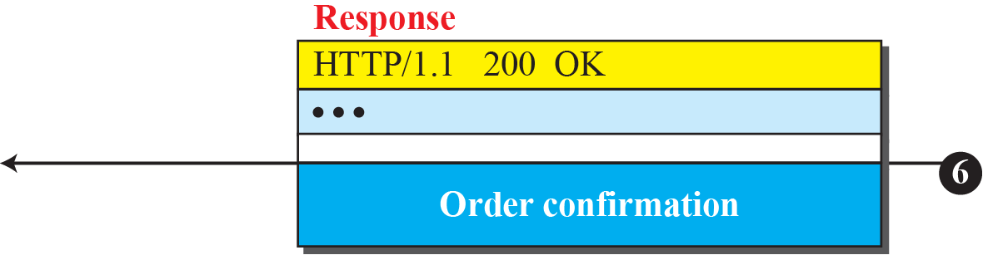
Example

Slide 37
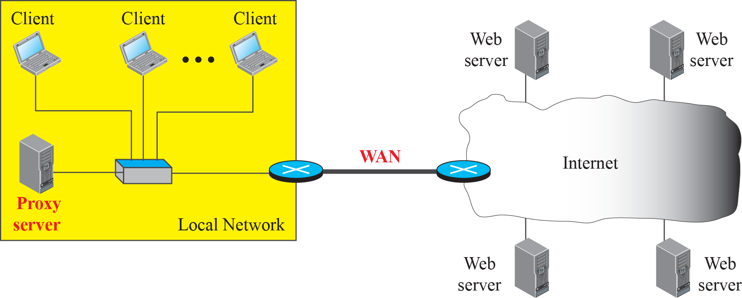
Example of a proxy server

Slide 38
Check Your Understanding
Difference between persistent and non persistent connections? Which on do you perfer? Why?
Status code 500 means_________________

Slide 39
Outcome
Student should be able to
Explain the need for web
Brief about the underlying technical details of HTTP

Slide 40
THANK YOU

